Slide 1
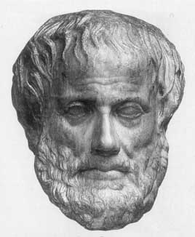
Lecture 10:
Machine Learning Overview
Junfeng Yao
Slides used in the classroom only

Slide 2
Lecture overview
Machine Learning Overview
Tom M. Mitchell, Machine Learning, McGraw-Hill, 1997

Slide 3
Machine Learning
What is learning?

Slide 4
Machine Learning
What is learning?
“That is what learning is. You suddenly understand something you've understood all your life, but in a new way.”
(Doris Lessing – 2007 Nobel Prize in Literature)

Slide 5
Machine Learning
How to construct programs that automatically improve with experience.
Definition: A computer program is said to learn from experience E with respect to some class of tasks T and performance measure P, if its performance at tasks in T, as measured by P, improves with experience E.

Slide 6
Machine Learning
How to construct programs that automatically improve with experience.
Learning problem:
  Task T
  Performance measure P
  Training experience E

Slide 7
Machine Learning
Chess game:
  Task T: playing chess games
  Performance measure P: percent of games won against opponents
  Training experience E: playing practice games against itself

Slide 8
Machine Learning
Handwriting recognition:
  Task T: recognizing and classifying handwritten words
  Performance measure P: percent of words correctly classified
  Training experience E: handwritten words with given classifications

Slide 9
Designing a Learning System
Choosing the training experience:
  Direct or indirect feedback
  Degree of learner's control
  Representative distribution of examples

Slide 10
Designing a Learning System
Choosing the target function:
  Type of knowledge to be learned
  Function approximation

Slide 11
Designing a Learning System
Choosing a representation for the target function:
  Expressive representation for a close function approximation
  Simple representation for simple training data and learning algorithms

Slide 12
Designing a Learning System
Choosing a function approximation algorithm (learning algorithm)

Slide 13
Designing a Learning System
Chess game:
  Task T: playing chess games
  Performance measure P: percent of games won against opponents
  Training experience E: playing practice games againts itself
  Target function: V: Board → R

Slide 14
Designing a Learning System
Chess game:
  Target function representation: a linear function
  V^(b) = w₀ + w₁x₁ + w₂x₂ + w₃x₃ + w₄x₄ + w₅x₅ + w₆x₆
  x₁: the number of black pieces on the board
  x₂: the number of red pieces on the board
  x₃: the number of black kings on the board
  x₄: the number of red kings on the board
  x₅: the number of black pieces threatened by red
  x₆: the number of red pieces threatened by black

Slide 15
Designing a Learning System
Chess game:
  Function approximation algorithm: target function value is 100
  (<x₁ = 3, x₂ = 0, x₃ = 1, x₄ = 0, x₅ = 0, x₆ = 0>, 100)
  x₁: the number of black pieces on the board
  x₂: the number of red pieces on the board
  x₃: the number of black kings on the board
  x₄: the number of red kings on the board
  x₅: the number of black pieces threatened by red
  x₆: the number of red pieces threatened by black

Slide 16
The Final Design: Checkers Learning System
Experiment
Generator
New problem
(initial board state)
Hypothesis
(V^)
Performance
System
Generalizer
Solution trace
(game history)
Training examples
{(b₁, V₁), (b₂, V₂), ...}
Critic
Critic: Training Rule

Slide 17
Issues in Machine Learning
What learning algorithms to be used?
How much training data is sufficient?
When and how prior knowledge can guide the learning process?
What is the best strategy for choosing a next training experience?
What is the best way to reduce the learning task to one or more function approximation problems?
How can the learner automatically alter its representation to improve its learning ability?

Slide 18
Inductive Reasoning
Learning in humans consists of (at least):
  memorisation, comprehension, learning from examples
Learning from examples
  Square numbers: 1, 4, 9 ,16
  1 = 1 * 1; 4 = 2 * 2; 9 = 3 * 3; 16 = 4 * 4;
  What is next in the series?
  We can learn this by example quite easily
Machine learning is largely dominated by
  Learning from examples
Inductive reasoning
  Induce a pattern (hypothesis) from a set of examples
    This is an unsound procedure (unlike deduction)

Slide 19
Machine Learning Tasks
Categorisation
  Learn why certain objects are categorised a certain way
  E.g, why are dogs, cats and humans mammals, but trout, mackeral and tuna are fish?
    Learn attributes of members of each category from background information, in this case: skin covering, eggs, homeothermic(恒温的),…
Prediction
  Learn how to predict how to categorise unseen objects
  E.g., given examples of financial stocks and a categorisation of them into safe and unsafe stocks
    Learn how to predict whether a new stock will be safe

Slide 20
A Hybrid Mixture of Neural Networks, Fuzzy Logic and Expert System for the Generation of Trading Signals in a Financial Market
(M.S. thesis: Willie Bossie)

Slide 21
Abstract
This research examines and analyzes the use of a combination of neural networks, fuzzy logic and expert systems as a stock-trading tool.
Accuracy is compared against a buy-and-hold strategy of stock selection.
This research demonstrated a 49% improvement over buy-and-hold strategy.

Slide 22
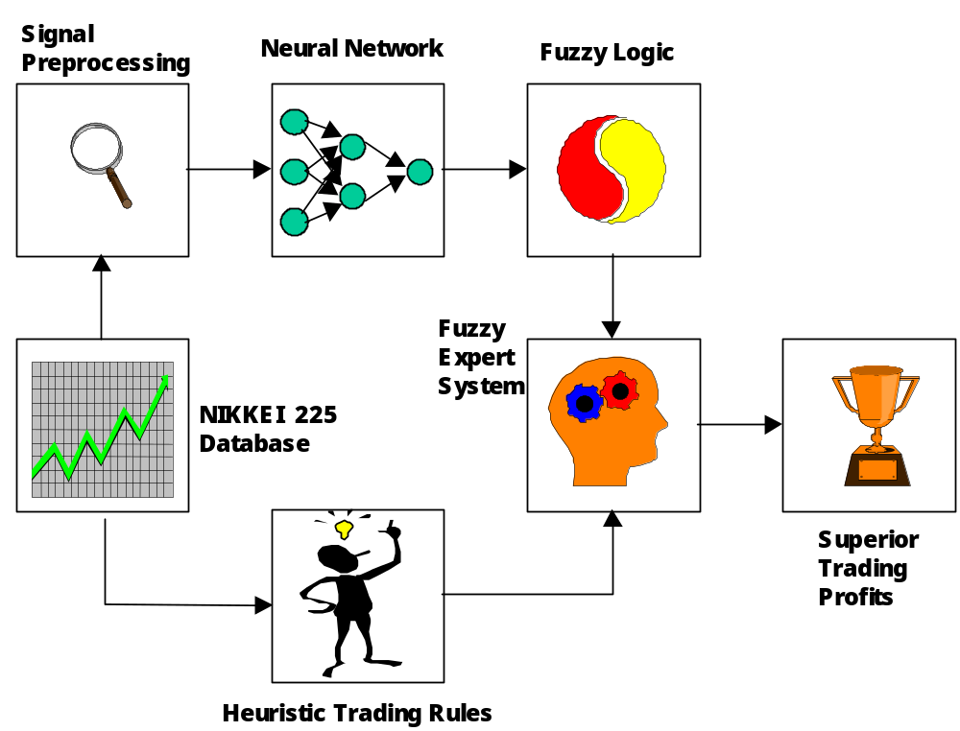
Hybrid Trading System

Slide 23
NIKKEI 225 Index
Most widely followed and most frequently quoted Japanese stock index.
Comprises 225 (18%) of the top-rated Japanese companies listed on the Tokyo Stock Exchange. (Honda, Toyota, and Sony)
Good indicator of economic conditions in Japan and Asia as well.

Slide 24
NIKKEI 225 Index closing prices for test period
(494 days from Jan 5, 1998 to Jan 6, 2000).
x 10
4
2
1.9
1.8
1.7
Price
1.6
1.5
1.4
1.3
1.2
0
50
100
150
200
250
300
350
400
450
500

Slide 25
The Hybrid Trading System
Consist of three major parts, a neural network, an expert system using fuzzy logic and a database of historical financial data
Hybrid Buy-and-Hold
Profit 15.91% 10.68%
Std. Dev. 7.70 16.01
Max Profit 30.93% 39.28%
Min Profit -1.94% -19.19%

Slide 26
Potential for Machine Learning
Agents can learn these from examples:
  which chemicals are toxic (biochemistry)
  which patients have a disease (medicine)
  which substructures proteins have (bioinformatics)
  what the grammar of a language is (natural language)
  which stocks and shares are about to drop (finance)
  which vehicles are tanks (military)
  which style a composition belongs to (music)

Slide 27
Performing Machine Learning
Specify your problem as a learning task
Choose the representation scheme
Choose the learning method
Apply the learning method
Assess the results and the method

Slide 28
Constituents of Learning Problems
The example set
The background concepts
The background axioms
The errors in the data

Slide 29
Problem constituents:
1. The Example Set
Learning from examples
  Express as a concept learning problem
  Whereby the concept solves the categorisation problem
Usually need to supply pairs (E, C)
  Where E is an example, C is a category
  Positives: (E,C) where C is the correct category for E
  Negatives: (E,C) where C is an incorrect category for E
Techniques which don’t need negatives
  Can learn from positives only
Questions about examples:
  How many does the technique need to perform the task?
  Do we need both positive and negative examples?

Slide 30
Example: Positives and Negatives
Problem: learn reasons for animal taxonomy(分类学)
  Into mammals, fish, reptile and bird
Positives:
  (cat=mammal); (dog=mammal); (trout=fish);
  (eagle=bird); (crocodile=reptile);
Negatives:
  (condor=fish); (mouse=bird); (trout=mammal);
  (platypus=bird); (human=reptile)

Slide 31
Problem Constituents:
2. Background Concepts
Concepts which describe the examples
  (Some of) which will be found in the solution to the problem
Some concepts are required to specify examples
  Example: pixel data for handwriting recognition (later)
  Cannot say what the example is without this
Some concepts are attributes of examples (functions)
  number_of_legs(human) = 2; covering(trout) = scales
Some concepts specify binary categorisations:
  is_homeothermic(human); lays_eggs(trout);
Questions about background concepts
  Which will be most useful in the solution?
    Which can be discarded without worry?
  Which are binary, which are functions?

Slide 32
Problem Constituents:
3. Background Axioms
Similar to axioms in automated reasoning
Specify relationships between
  Pairs of background concepts
Example:
  has_legs(X) = 4  covering(X) = hair or scales
Can be used in the search mechanism
  To speed up the search
Questions about background axioms:
  Are they correct?
  Are they useful for the search, or surplus?

Slide 33
Problem Constituents:
4. Errors in the Data
In real world examples
  Errors are many and varied, including:
Incorrect categorisations:
  E.g., (platypus=bird) given as a positive example
Missing data
  E.g., no skin covering attribute for falcon
Incorrect background information
  E.g, is_homeothermic(lizard)
Repeated data
  E.g., two different values for the same function and input
  covering(platypus)=feathers & covering(platypus)=fur

Slide 34
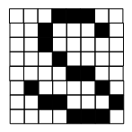
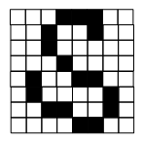
Another Example:
Handwriting Recognition
Positive:
  This is a letter S:
Negative:
  This is a letter Z:
Background concepts:
  Pixel information
Categorisations:
  (Matrix, Letter) pairs
  Both positive & negative
Task
  Correctly categorise
    An unseen example
  Into 1 of 26 categories

Slide 35
Constituents of Methods
The representation scheme
The search method
The method for choosing from rival solutions

Slide 36
Method Constituents
1. Representation
Must choose how to represent the solution
  Very important decision
Three assessment methods for solutions
  Predictive accuracy (how good it is as the task)
    Can use black box methods (accurate but incomprehensible)
  Comprehensibility (how well we understand it)
    May trade off some accuracy for comprehensibility
  Utility (problem-specific measures of worth)
    Might override both accuracy and comprehensibility
    Example: drug design (must be able to synthesise the drugs)

Slide 37
Examples of Representations
The name is in the title…
Inductive logic programming
  Representation scheme is logic programs
Decision tree learning
  Representation scheme is decision trees
Neural network learning
  Representation scheme is neural networks
Other representation schemes
  Hidden Markov Models
  Bayesians Networks
  Support Vector Machines

Slide 38
Method Constituents
2. Search
Some techniques don’t really search
  Example: neural networks
Other techniques do perform search
  Example: inductive logic programming
Can specify search as before
  Search states, initial states, operators, goal test
Important consideration
  General to specific or specific to general search
  Both have their advantages

Slide 39
Method constituents
3. Choosing a hypothesis
Some learning techniques return one solution
Others produce many solutions
  May differ in accuracy, comprehensibility & utility
Question: how to choose just one from the rivals?
  Need to do this in order to
    (i) give the users just one answer
    (ii) assess the effectiveness of the technique
Usual answer: Occam’s razor
  All else being equal, choose the simplest solution
When everything is equal
  May have to resort to choosing randomly

Slide 40
Example method: FIND-S
This is a specific to general search
  Guaranteed to find the most specific solutions (of the best)
Idea:
  At the start:
    Generate a set of most specific hypotheses
    From the positives (solution must be true of at least 1 pos)
  Repeatedly generalise hypotheses
    So that they become true of more and more positives
  At the end:
    Work out which hypothes(es) are true of
      The most positives and the fewest negatives (pred. accuracy)
      Take the most specific one out of the most accurate ones

Slide 41
Example method: FIND-S …
Example | Sky | AirTemp | Humidity | Wind | Water | Forecast | EnjoySport
1 | Sunny | Warm | Normal | Strong | Warm | Same | Yes
2 | Sunny | Warm | High | Strong | Warm | Same | Yes
3 | Rainy | Cold | High | Strong | Warm | Change | No
4 | Warm | Warm | High | Strong | Cool | Change | Yes
Table 2.1: describes a set of example days, each represented by a set of attributes. Positive and negative training examples for the target concept EnjoySport.

Slide 42
Example method: FIND-S …
An example task of learning the target concept “days on which my friend Aldo enjoys his favorite water sport.”
The task is to learn to predict the value of EnjoySport for an arbitrary day, based on the values of its other attributes.
What hypothesis representation shall we provide to the learner in this case?

Slide 43
Example method: FIND-S …
Let each hypothesis be a vector of six constraints, specifying the values of the six attributes.
For each attribute, the hypothesis will either
  Indicate by a “?” that any value is acceptable for this attribute,
  Specify a single required value (e.g., Warm) for the attribute, or
  Indicate by a “Ø” that no value is acceptable.

Slide 44
Example method: FIND-S …
If some instance x satisfies all the constraints of hypothesis h, then h classifies x as a positive example (h(x) = 1).
To illustrate, the hypothesis that Aldo enjoys his favorite sport only on cold days with high humidity (independent of the values of the other attributes) is represented by the expression
<?, Cold, High, ?, ?, ?>

Slide 45
Example method: FIND-S …
The most general hypothesis – that every day is a positive example – is represented by
    <?, ?, ?, ?, ?, ?>
The most specific possible hypothesis – that no day is a positive example – is represented by
    <Ø, Ø, Ø, Ø, Ø, Ø>
To summarize, the EnjoySport concept learning task requires learning the set of days for which EnjoySport = yes, describing this set by a conjunction of constraints over the instance attributes.

Slide 46
Assessing Hypotheses
Given a hypothesis H
False positives (FP)
  An example which is categorised as positive by H
  But in reality it was a negative example
False negatives (FN)
  An example which is categorised as negative by H
  But in reality it was a positive example
Sometimes we don’t mind FPs as much as FNs
  Example: medical diagnosis
    FN is someone predicted to be well who actually has disease
  But what if the treatment has severe side effects?

Slide 47
Predictive Accuracy over the Examples Supplied
Simply work out the proportion of examples
  which were correctly categorised by the chosen hypothesis
In fact, this is used to choose the hypothesis
  in the first place
Question:
  Is this a good indication of how the learning method will perform in future
  E.g., given a genuinely new drug and a family about which we know toxicity (to learn from)
    What is the likelihood of the FIND-S method producing a hypothesis which correctly categorises the new drug?

Slide 48
Illustrative Example
Positives:
Apple, Orange, Lemon, Melon, Strawberry
Negatives:
Banana, Passionfruit, Plum, Coconut, Apricot

Slide 49
Answers in terms of
Predictive Accuracy over Examples
Hypothesis one:
  Positives are citrus fruits
  Scores 7 out of 10 for predictive accuracy (2p + 5N)
Hypothesis two:
  Positives contain the letter ‘l’
  Also scores 7 out of 10 for predictive accuracy (3p + 4N)
Hypothesis three:
  Positives are either
    Apple, Orange, Lemon, Melon or Strawberry
  Scores 10 out of 10 for predictive accuracy. Hoorah!

Slide 50
The Real Test:
Is Lime a positive or a negative?
My underlying assumption was about the letter ‘e’
  All positive fruits have a letter ‘e’ in them
  Hence Lime is a positive
So, hypotheses one and two get this right
  It is a citrus fruit and it does have an ‘l’ in it
But hypothesis three got this wrong
  Even though this was seemingly the best at predicting

Slide 51
Training and Test sets
Standard technique for evaluating learning methods
  Split the data into two sets:
  Training set: used to learn the method
  Test set: used to test the accuracy of the learned hypothesis on unseen examples
We are most interested in the performance of the learned concept on the test set

Slide 52
Methodologies for splitting data
Leave one out method
  For small datasets (<30 approx)
  Randomly choose one example to put in the test set
  Lime was left out in our example
  Repeatedly choose single examples to leave out
    Remember to perform the learning task every time
Hold back method
  For large datasets (thousands)
  Randomly choose a large set (poss. 20-25%) to put into the test set

Slide 53
Cross Validation Method
n-fold cross validation:
  Split the (entire) example set into n equal partitions
    Must cover the entire set (nearly)
    Partitions have no elements in common (empty intersections)
  Use each partition in turn as the test set
  Repeatedly perform the learning task and work out the predictive accuracy over the test set
  Average the predictive accuracy over all partitions
    Gives you an indication of how the method will perform in real tests when a genuinely new example is presented
10-fold cross validation is very common
1-fold cross validation is the same as leave-one-out

Slide 54
Overfitting
We say that hypothesis three was overfitting
  It is memorising examples,
    Rather than generalising examples
Formal definition:
  A learning method is overfitting if it finds a hypothesis H such that:
    There is another hypothesis H’ where
      H scores better on the training set than H’
      But H’ scores better on the test set than H
In our example, H = hyp 3, H’ = hyp 2

Slide 55
Concept Learning
Inferring a boolean-valued function from training examples of its input (instances) and output (classifications).

Slide 56
Concept Learning
Experience
Example | Sky | AirTemp | Humidity | Wind | Water | Forecast | EnjoySport
1 | Sunny | Warm | Normal | Strong | Warm | Same | Yes
2 | Sunny | Warm | High | Strong | Warm | Same | Yes
3 | Rainy | Cold | High | Strong | Warm | Change | No
4 | Sunny | Warm | High | Strong | Cool | Change | Yes
Prediction
5 | Sunny | Cold | Normal | Strong | Warm | Same | ?
6 | Rainy | Warm | High | Strong | Warm | Change | ?

Slide 57
Concept Learning
Learning problem:
  Task T: classifying days on which my friend enjoys water sport
  Performance measure P: percent of days correctly classified
  Training experience E: days with given attributes and classifications

Slide 58
Concept Learning
Learning problem:
  Concept: a subset of the set of instances X
  c: X → {0, 1}
  Target function:
  Sky × AirTemp × Humidity × Wind × Water × Forecast → {Yes, No}
  Hypothesis:
  Characteristics of all instances of the concept to be learned = Constraints on instance attributes
  h: X → {0, 1}

Slide 59
Concept Learning
Satisfaction:
h(x) = 1 iff x satisfies all the constraints of h
h(x) = 0 otherwsie
Consistency:
h(x) = c(x) for every instance x of the training examples
Correctness:
h(x) = c(x) for every instance x of X

Slide 60
Concept Learning
Hypothesis representation:
<Sky, AirTemp, Humidity, Wind, Water, Forecast>
  ?: any value is acceptable
  single required value
  ∅: no value is acceptable

Slide 61
Concept Learning
General-to-specific ordering of hypotheses:
h_{j} ≥_{g} h_{k} iff ∀x∈X: h_{k}(x) = 1 ⇒ h_{j}(x) = 1
Specific
h₁ = <Sunny, ?, ?, Strong, ? , ?>
h₂ = <Sunny, ?, ?, ? , ? , ?>
h₃ = <Sunny, ?, ?, ? , Cool, ?>
h₁
h₃
h₂
H
General

Slide 62
FIND-S
Initialize h to the most specific hypothesis in H:
For each positive training instance x:
For each attribute constraint a_{i} in h:
If the constraint is not satisfied by x
Then replace a_{i} by the next more general
constraint satisfied by x
Output hypothesis h

Slide 63
FIND-S
Example | Sky | AirTemp | Humidity | Wind | Water | Forecast | EnjoySport
1 | Sunny | Warm | Normal | Strong | Warm | Same | Yes
2 | Sunny | Warm | High | Strong | Warm | Same | Yes
3 | Rainy | Cold | High | Strong | Warm | Change | No
4 | Sunny | Warm | High | Strong | Cool | Change | Yes
h = < ∅ , ∅ , ∅ , ∅ , ∅ , ∅ > most specific hypothesis
h = <Sunny, Warm, Normal, Strong, Warm, Same> still very specific
h = <Sunny, Warm, ? , Strong, Warm, Same>
h = <Sunny, Warm, ? , Strong, ? , ? >

Slide 64
FIND-S
The output hypothesis is the most specific one that satisfies all positive training examples.

Slide 65
FIND-S
The result is consistent with the positive training examples.
The result is consistent with the negative training examples if the correct target concept is contained in H (and the training examples are correct).

Slide 66
FIND-S
Questions:
  Has the learner converged to the correct target concept, as there can be several consistent hypotheses?
  Why prefer the most specific hypothesis?
  What if there are several maximally specific consistent hypotheses?
  Are the training examples correct? Errors or noise

Slide 67
List-then-Eliminate Algorithm
Version space: a set of all hypotheses that are consistent with the training examples.
Algorithm:
  Initial version space = set containing every hypothesis in H
  For each training example <x, c(x)>, remove from the version space any hypothesis h for which h(x) ≠ c(x)
  Output the hypotheses in the version space

Slide 68
List-then-Eliminate Algorithm
Requires an exhaustive enumeration of all hypotheses in H

Slide 69
Compact Representation of
Version Space
G (the generic boundary): set of the most generic hypotheses of H consistent with the training data D:
G = {g∈H | consistent(g, D) ∧ ¬∃g’∈H: g’ >_{g} g ∧ consistent(g’, D)}
S (the specific boundary): set of the most specific hypotheses of H consistent with the training data D:
S = {s∈H | consistent(s, D) ∧ ¬∃s’∈H: s >_{g} s’ ∧ consistent(s’, D)}

Slide 70
Compact Representation of
Version Space
Version space = <G, S> = {h∈H | ∃g∈G ∃s∈S: g ≥_{g} h ≥_{g} s}
S
G

Slide 71
Candidate-Elimination Algorithm
Initialize G to the set of maximally general hypotheses in H
Initialize S to the set of maximally specific hypotheses in H

Slide 72
Candidate-Elimination Algorithm
For each positive example d:
  Remove from G any hypothesis inconsistent with d
  For each s in S that is inconsistent with d:
    Remove s from S
    Add to S all least generalizations h of s, such that h is consistent with d and some hypothesis in G is more general than h
    Remove from S any hypothesis that is more general than another hypothesis in S

Slide 73
Candidate-Elimination Algorithm
For each negative example d:
  Remove from S any hypothesis inconsistent with d
  For each g in G that is inconsistent with d:
    Remove g from G
    Add to G all least specializations h of g, such that h is consistent with d and some hypothesis in S is more specific than h
    Remove from G any hypothesis that is more specific than another hypothesis in G

Slide 74
Candidate-Elimination Algorithm
S₀ = {<∅, ∅, ∅, ∅, ∅, ∅>}
G₀ = {<?, ?, ?, ?, ?, ?>}
S₁ = {<Sunny, Warm, Normal, Strong, Warm, Same>}
G₁ = {<?, ?, ?, ?, ?, ?>}
S₂ = {<Sunny, Warm, ?, Strong, Warm, Same>}
G₂ = {<?, ?, ?, ?, ?, ?>}
S₃ = {<Sunny, Warm, ?, Strong, Warm, Same>}
G₃ = {<Sunny, ?, ?, ?, ?, ?>, <?, Warm, ?, ?, ?, ?>, <?, ?, ?, ?, ?, Same>}

Slide 75
Candidate-Elimination Algorithm
S4 = {<Sunny, Warm, ?, Strong, ?, ?>}
<Sunny, ?, ?, Strong, ?, ?> <Sunny, Warm, ?, ?, ?, ?> <?, Warm, ?, Strong, ?, ?>
G4 = {<Sunny, ?, ?, ?, ?, ?>, <?, Warm, ?, ?, ?, ?>}

Slide 76
Candidate-Elimination Algorithm
The version space will converge toward the correct target concepts if:
  H contains the correct target concept
  There are no errors in the training examples
A training instance to be requested next should discriminate among the alternative hypotheses in the current version space:
Partially learned concept can be used to classify new instances using the majority rule.

Slide 77
Inductive Bias
Inductive bias refers to any criteria a learner uses to constrain the concept space or to select concepts within that space.
Size of the instance space: |X| = 3.2.2.2.2.2 = 96
Number of possible concepts = 2^{|X|} = 2⁹⁶
Size of H = (4.3.3.3.3.3) + 1 = 973 << 2⁹⁶

Slide 78
Inductive Bias
Size of the instance space: |X| = 3.2.2.2.2.2 = 96
Number of possible concepts = 2^{|X|} = 2⁹⁶
Size of H = (4.3.3.3.3.3) + 1 = 973 << 2⁹⁶
⇒ a biased hypothesis space

Slide 79
Inductive Bias
An unbiased hypothesis space H’ that can represent every subset of the instance space X: Propositional logic sentences
Positive examples: x₁, x₂, x₃
Negative examples: x₄, x₅
h = x₁∨ x₂ ∨ x₃ ∨ x₆

Slide 80
Inductive Bias
x₁∨ x₂ ∨ x₃
x₁∨ x₂ ∨ x₃ ∨ x₆
¬x₄ ∧ ¬x₅
Any new instance x is classified positive by half of the version space, and negative by the other half.

Slide 81
Inductive Bias
Example | Day | Actor | Price | EasyTicket
1 | Mon | Famous | Expensive | Yes
2 | Sat | Famous | Moderate | No
3 | Sun | Infamous | Cheap | No
4 | Wed | Infamous | Moderate | Yes
5 | Sun | Famous | Expensive | No
6 | Thu | Infamous | Cheap | Yes
7 | Tue | Famous | Expensive | Yes
8 | Sat | Famous | Cheap | No
9 | Wed | Famous | Cheap | ?
10 | Sat | Infamous | Expensive | ?

Slide 82
Inductive Bias
Example | Quality | Price | Buy
1 | Good | Low | Yes
2 | Bad | High | No
3 | Good | High | ?
4 | Bad | Low | ?

Slide 83
Inductive Bias
A learner that makes no prior assumptions regarding the identity of the target concept cannot classify any unseen instances.

Slide 84


Questions & Suggestions?
The End

